Slide 1
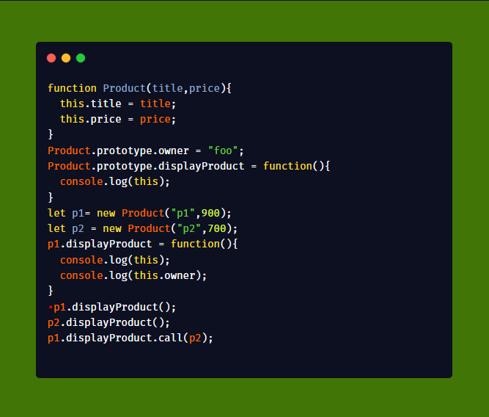
‘this’ in JavaScript
Dhananjay Kumar
Teacher, Author, MVP, GDE
Founder, <geek97/>
https://debugmode.net

Slide 2
function Product(title,price){
this.title = title;
this.price = price;
}
Product.prototype.owner = "foo";
Product.prototype.displayProduct = function(){
console.log(this);
}
let p1= new Product("p1",900);
let p2 = new Product("p2",700);
p1.displayProduct = function(){
console.log(this);
console.log(this.owner);
}
p1.displayProduct();
p2.displayProduct();
p1.displayProduct.call(p2);

Slide 3
Find various ways to calculate value of ‘this’ inside a function
Various Invocation Patterns
FIP
CIP
MIP
IIP
Agenda
@debug_mode

Slide 4
In object-oriented programming languages, this is a variable which refers to the current object
Wikipedia
@debug_mode

Slide 5
But, for the JavaScript ,
below definition of ‘this’ is not true,
In object-oriented programming languages, this is a variable which refers to the current object
@debug_mode

Slide 6
JavaScript is not a truly object-oriented language
But, it has objects as the first class citizen
Every function has it’s own ‘this’ object.
Why?
@debug_mode

Slide 7
In JavaScript every function has it’s own ‘this’ object
Function
this object
@debug_mode

Slide 8
JavaScript determines the value of ‘this’ inside a function based on the way the function is called
‘this’
Depends on how the function is called
Does not depend on how the function is created *
@debug_mode

Slide 9
In JavaScript ,
Calling a function
Invocation Patterns
@debug_mode

Slide 10
Function Invocation Pattern
Constructor Invocation Pattern
Method Invocation Pattern
Indirect Invocation Pattern
Invocation Patterns
@debug_mode

Slide 11
There are four invocation patterns
There are four ways a function can be called
There are 4 ways value of ‘this’ can be calculated inside a function
@debug_mode

Slide 12
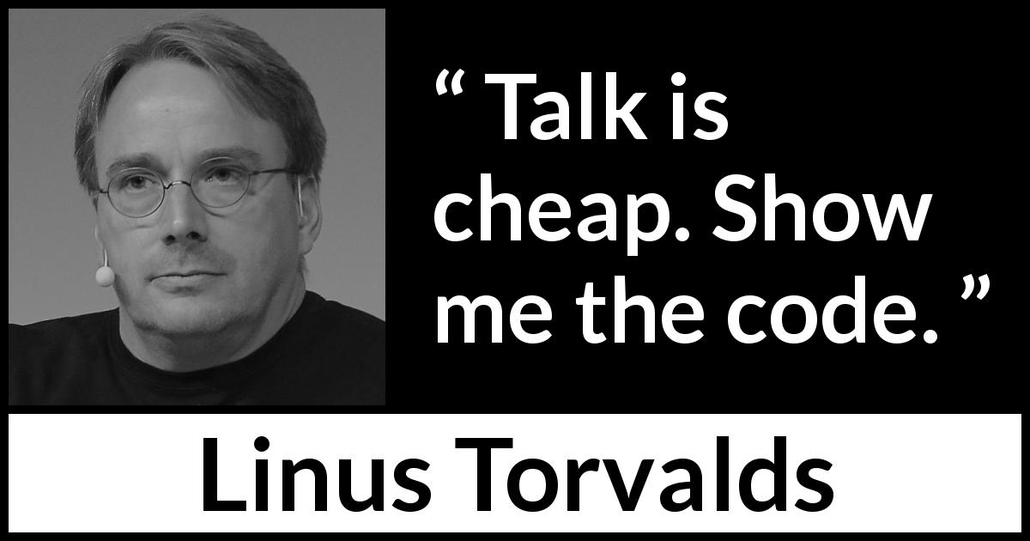
@debug_mode

Slide 13
Function Invocation Pattern
Function is invoked as a function
Value of ‘this’ is always the global object
@debug_mode

Slide 14
Function Invocation Pattern
this == global object
function Product(title,price){
this.title = title;
this.price = price;
console.log(this); // global object
return 9;
}
let p1 = Product(); // called as a function
console.log(p1); // 9
@debug_mode

Slide 15
Function is called using ‘new’
Function acts as a constructor and returns newly created object
Value of ‘this’ is the newly created object
Constructor Invocation Pattern
@debug_mode

Slide 16
Constructor Invocation Pattern
this == newly created object
function Product(title, price) {
this.title = title;
this.price = price;
console.log(this); // newly created object
return 9;
}
let p1 = new Product('Pen', 1000); // called as a constructor
console.log(p1); // newly created object
@debug_mode

Slide 17
Function is invoked as a method
Function is part of an object
Value of ‘this’ is always the object used to call the method
Method Invocation Pattern
@debug_mode

Slide 18
Method Invocation Pattern
this == object calling the method
var Product = {
title: 'Pen',
price: 900,
displayProduct: function () {
console.log(this); // Product Object
return 9;
}
}
let p1 = Product.displayProduct(); // called as a method
console.log(p1); // 9
@debug_mode

Slide 19
Function is invoked indirectly using apply, call, or bind method
Value of ‘this’ is manually passed as first parameter of apply and call
New object is created and passed as value of ‘this’ for the bind
Indirect Invocation Pattern
@debug_mode

Slide 20
Indirect Invocation Pattern
this == can be manually passed
var Car = {
color: 'red',
owner: 'foo',
price: 1000
}
function Product(title, price) {
this.title = title;
this.price = price;
console.log(this); // Car object with passed title and price properties
return 9;
}
let p2 = Product.apply(Car, ['Pen', 1000]); // Indirectly called using apply
let p1 = Product.call(Car, 'Pencil', 700); // Indirectly called using call
console.log(p1); // 9
console.log(Car); // only one Car object
@debug_mode

Slide 21
this
FIP
global object
CIP
newly created object
MIP
object calling method
IIP
manually passed
@debug_mode

Slide 22
But there is a catch ,
So far, we have learnt that value of this inside a function depends on how a function is invoked
However, it also depends on the type of the function or how the function is created
@debug_mode

Slide 23
Function Declaration
Function Expression
Arrow function
Function created using function constructor
4 ways of creating a function
@debug_mode

Slide 24
function Declaration
Function Expression
Function Constructor
Depends on the Invocation Pattern
Arrow function
Does not have its own ‘this’
Inherits from the enclosing scope
@debug_mode

Slide 25
Arrow function
this == inherited from the scope
var Car = {
color: 'red',
owner: 'foo',
price: 1000
}
var displayProduct = (title, price) => {
this.title = title;
this.price = price;
console.log(this); // object of the execution context
return 9;
}
var a = displayProduct('Pen', 900); // add to current context
console.log(a); // 9
console.log(this); // current context
this.owner = "dj";
console.log(this);
displayProduct.call(Car, 'Pencil', 900); // will call and pass undefined,
console.log(this); // context object updated with pencil and 900
console.log(Car); // car object
@debug_mode

Slide 26
function Product(title,price){
this.title = title;
this.price = price;
}
Product.prototype.owner = "foo";
Product.prototype.displayProduct = function(){
console.log(this);
}
let p1= new Product("p1",900);
let p2 = new Product("p2",700);
p1.displayProduct = function(){
console.log(this);
console.log(this.owner);
}
p1.displayProduct();
p2.displayProduct();
p1.displayProduct.call(p2);

Slide 27
Thank you
debugmode@outlook.com
Questions
Resources
Book – You don’t know JavaScript by Kyle Simpson
Book – JavaScript for Impatient Programmer by Dr Axel Rauschmayer
Blog - https://debugmode.net/category/javascript-2/
@debug_mode

